Slide 1
M aker Movement in K-12 Education
Jason Harron
Doctoral Student, Curriculum & Instruction
jasonharron@utexas.edu @JRHarron

Slide 2
hat is the aker
ovement?

Slide 3
What is the Maker Movement?
The maker culture is a contemporary culture or subculture representing a technology-based extension of DIY culture. Typical interests enjoyed by the maker culture include engineering-oriented pursuits such as:
There is a strong focus on using and learning practical skills and applying them creatively.
Technology
Electronics
Robotics
3-D Printing
CNC Tools
Traditional
Metalworking
Woodworking
Arts
Crafts
From http://en.wikipedia.org/wiki/Maker_culture

Slide 4
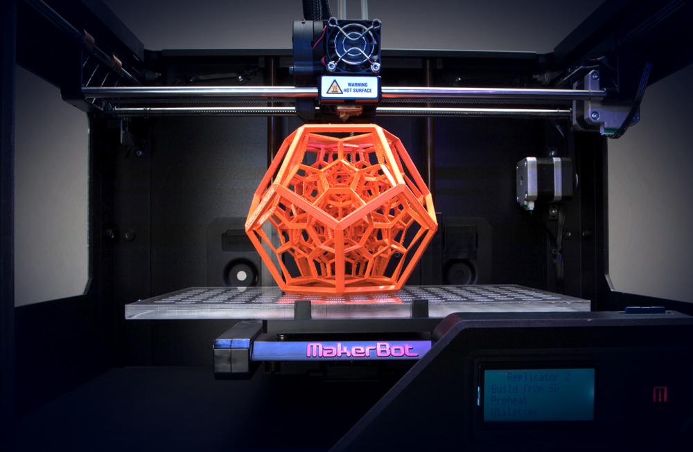
Source: https://www.thegrommet.com/blog/the-maker-movement-in-motion/

Slide 5
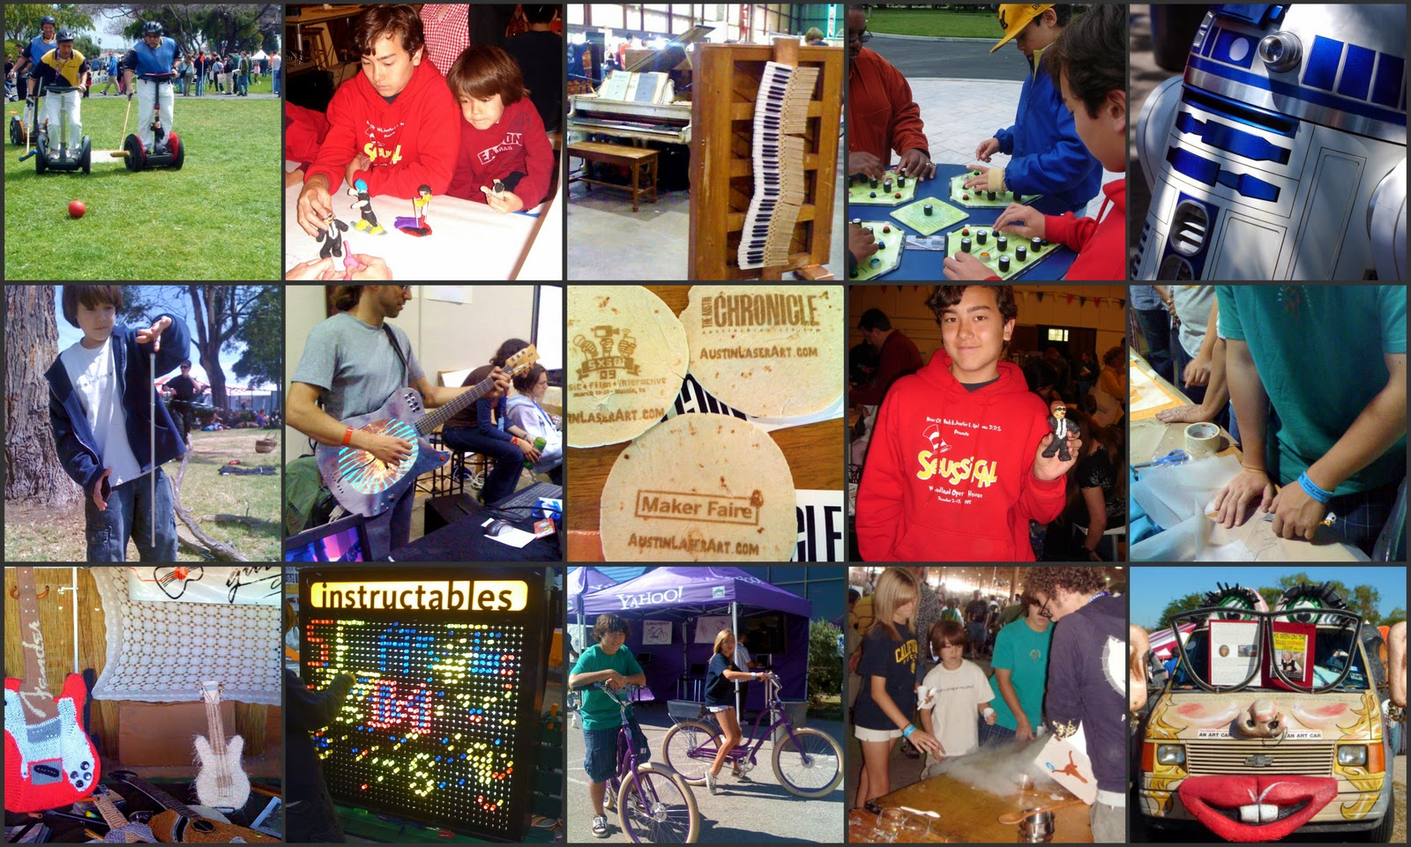

Slide 6
hy does aking matter
in ducation?

Slide 7
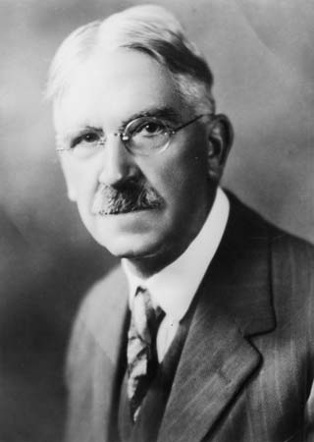
“Then there is the instinct of making – the constructive impulse.”
The School and Society (1915, p. 43)
John Dewey
(1859 - 1952)

Slide 8
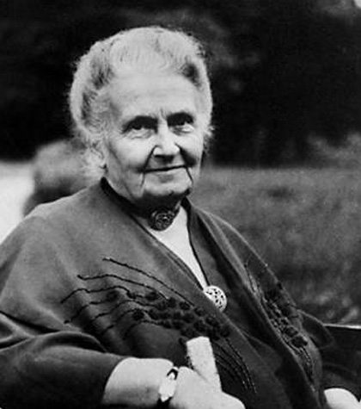
“The hands are the instrument of man’s intelligence.”
“The environment must be rich in motives which lend interest to activity and invite the child to conduct his own experiences.”
Maria Montessori
(1870 - 1952)

Slide 9
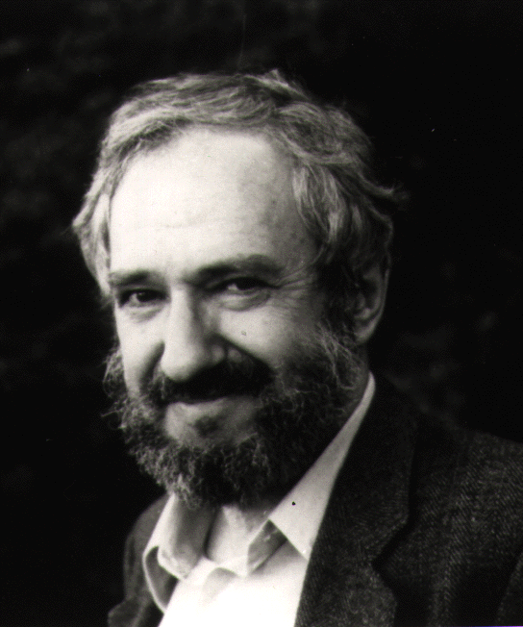
Constructionism is a constructivist learning theory and theory of instruction. It states that building knowledge occurs best through building things that are tangible and sharable (Ackerman et al., 2009: 56).
Seymour Papert
(1928 - )

Slide 10
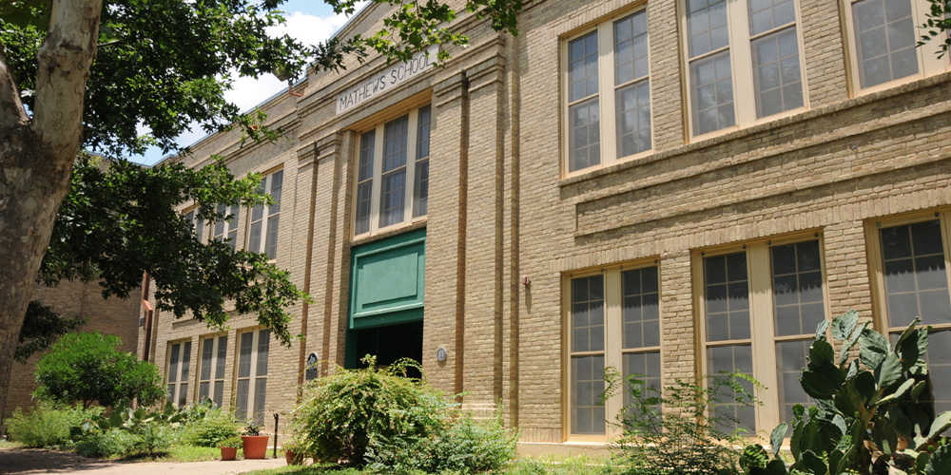
ow is this taking place in Austin ISD? Mathews Elementary (Click picture for link)

Slide 11
Overview
Teach 3
Remember to upload forms
E-mail about any rescheduled dates
Introduction to Maker Movement in Education
Hands-on Making
Introduction to Final Project

Slide 12
hat is a akerspace?

Slide 13
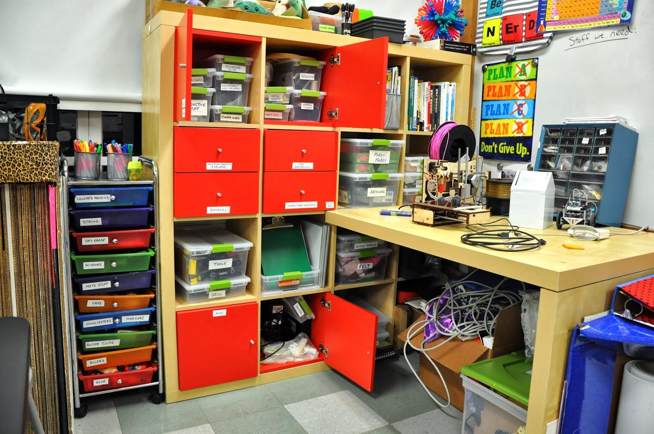
Does making have to be high-tech with 3-D printers and laser cutters?

Slide 14
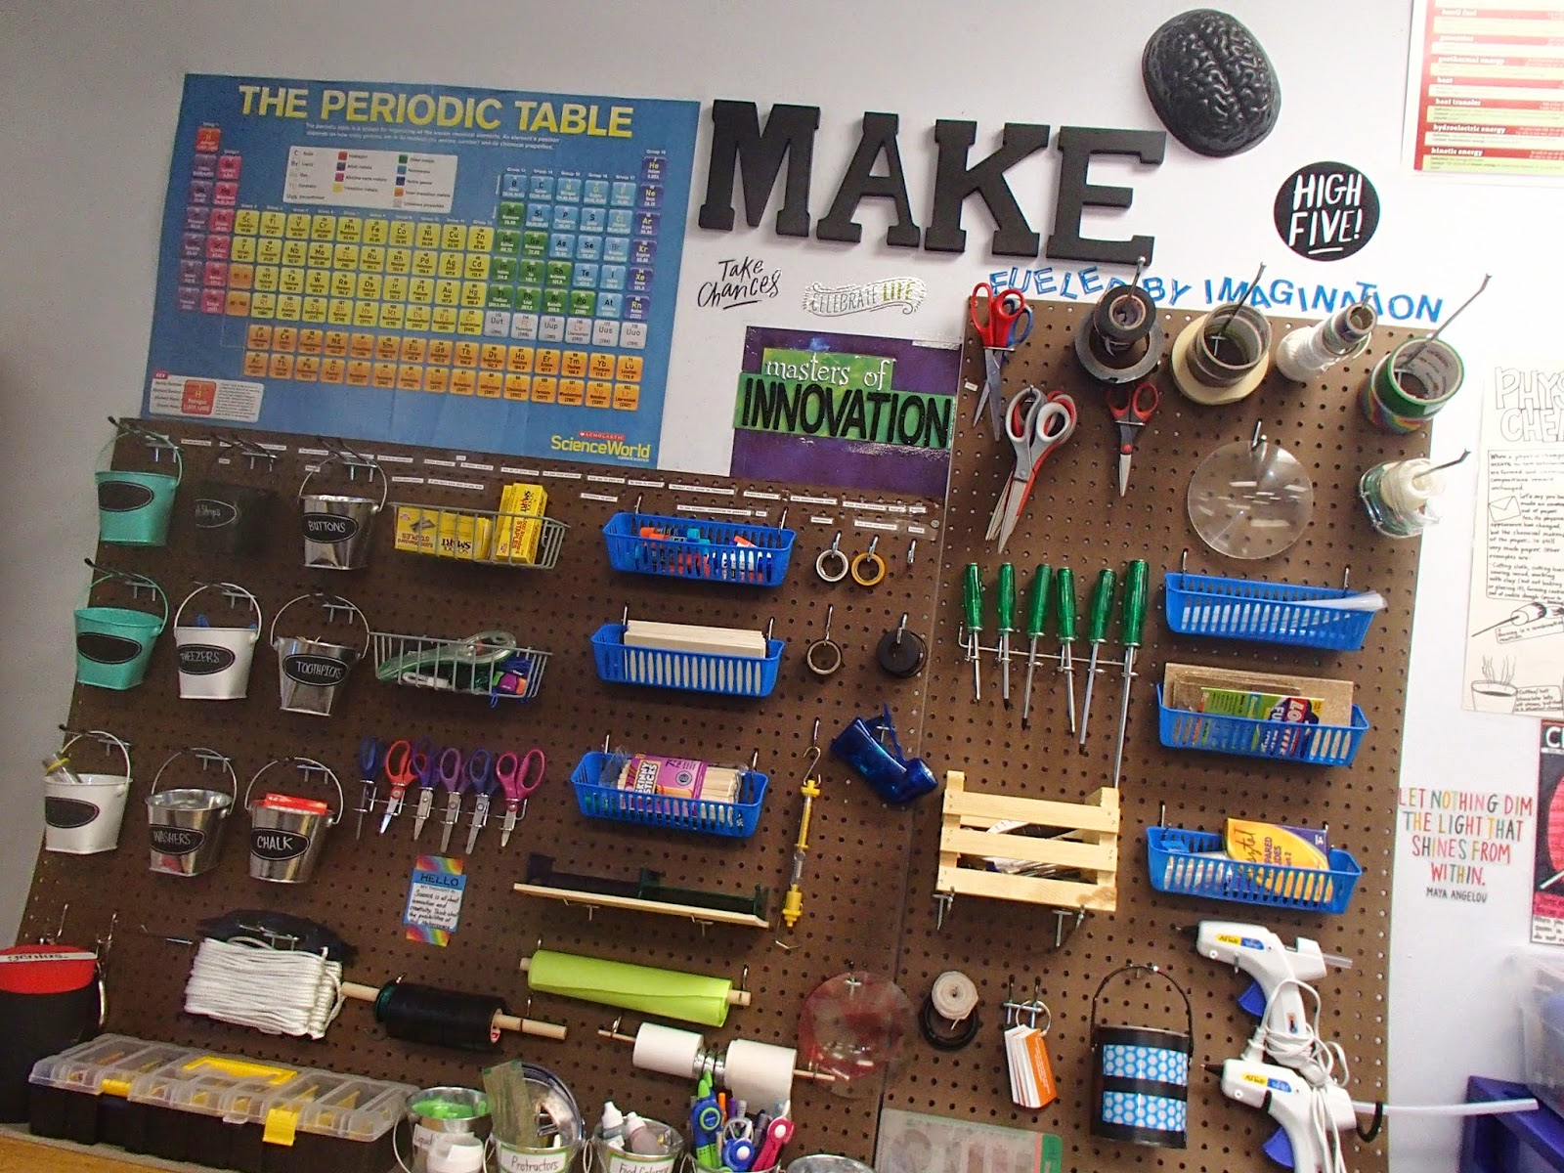
What does making look like in an elementary school?

Slide 15
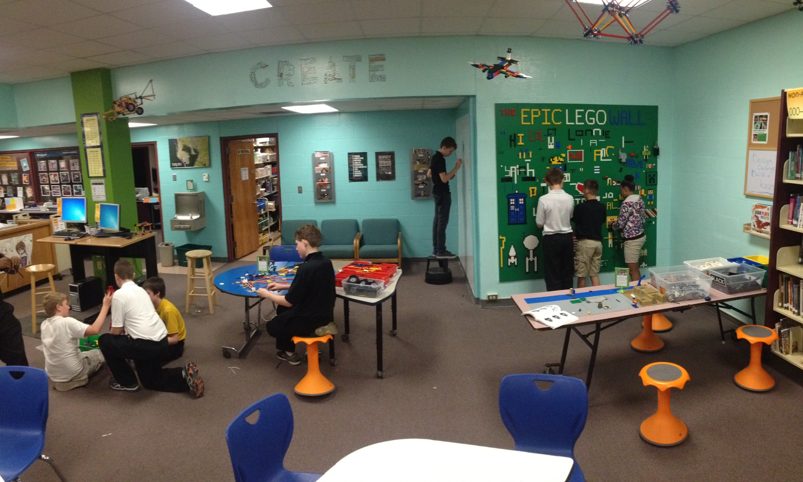

Slide 16
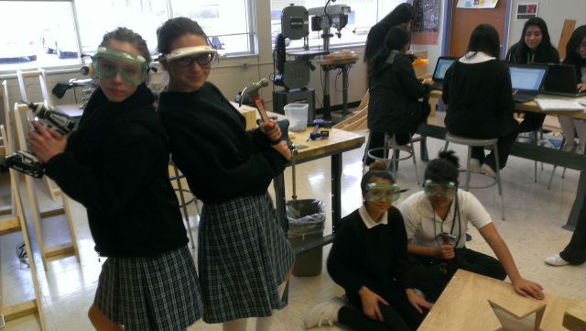
Ann Richards Middle School Austin ISD

Slide 17
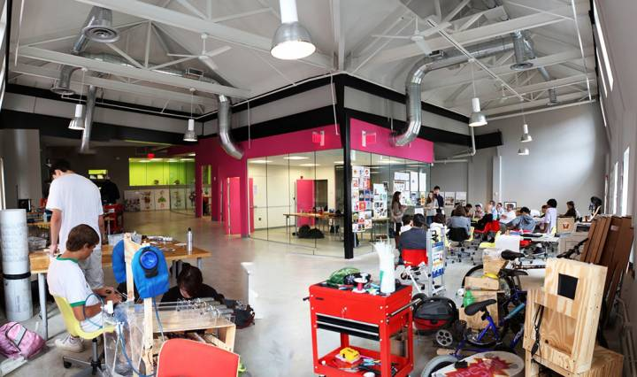
High School Spaces NuVu Studio Cambridge, MA

Slide 18
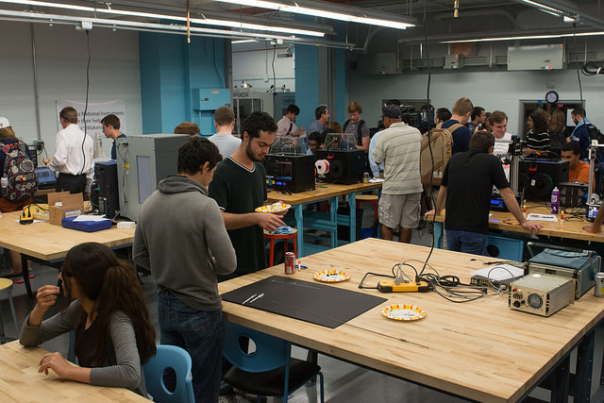
University Spaces UT Longhorn Maker Studio

Slide 19
Public Spaces

Slide 20
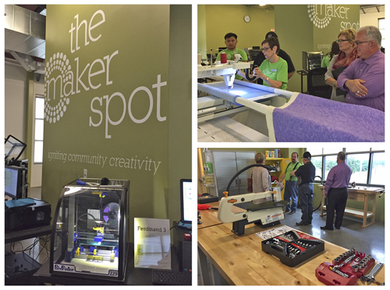
Public Library Spaces The Maker Spot – North Richland Hills Public Library

Slide 21
hat is a akey akey?
Let’s play!
http://makeymakey.com/piano/

Slide 23
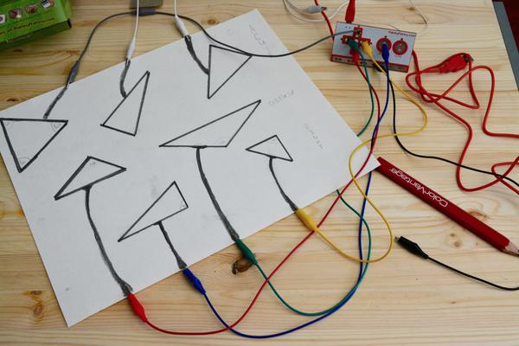

Slide 24
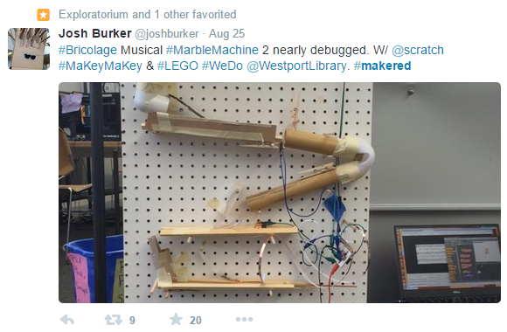

Slide 25
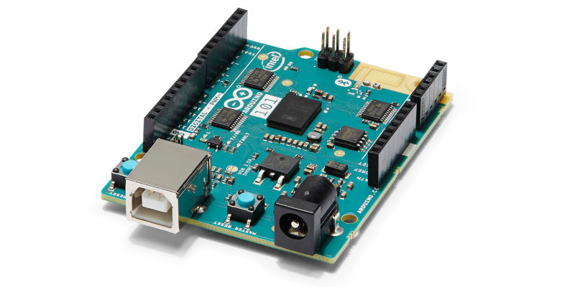
hat is an rduino?

Slide 26
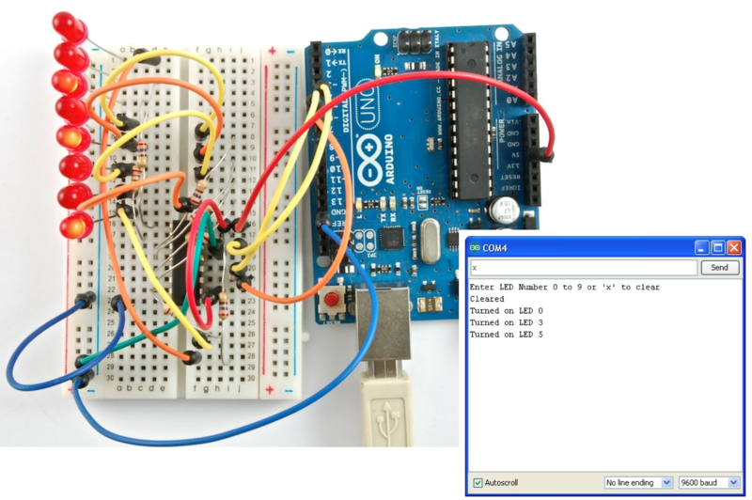

Slide 27
dditional esources
Twitter
#makered
#makerspaces
Facebook
MakerSpaces and the Participatory Library
Other
Geekbus – San Antonio based mobile makerspace
TechShop – Round Rock, TX
ATX Hackerspace – Austin, TX

